Slide 1
Hotel Review
File created on: 6/8/2021 11:11:03 AM

Slide 2
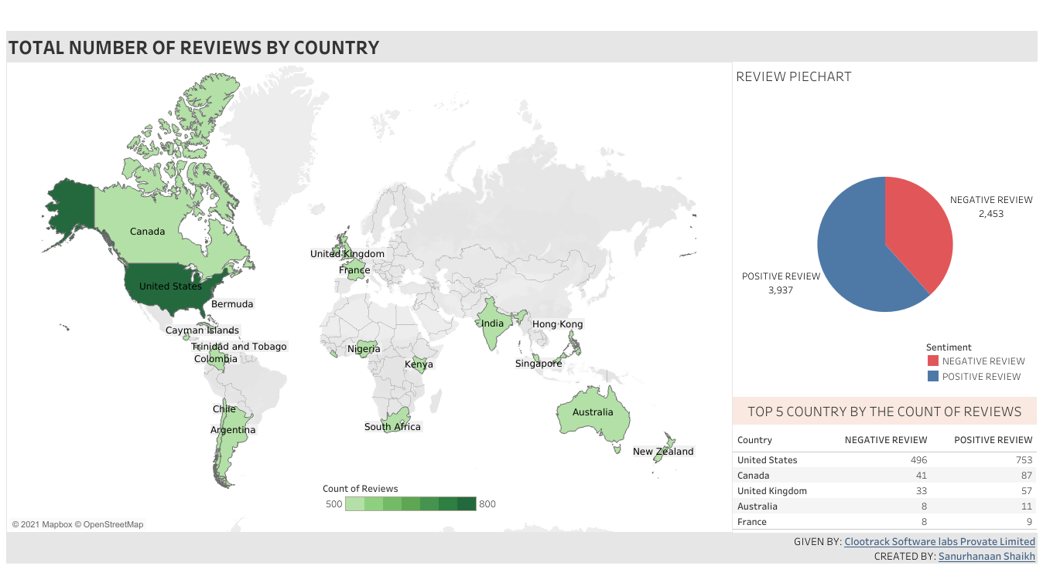

Slide 3
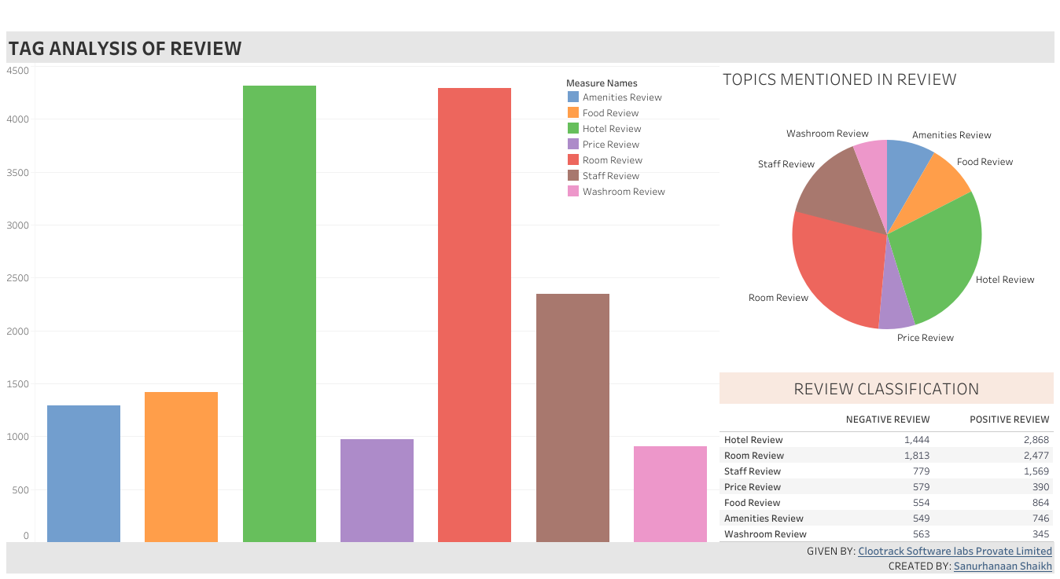

Slide 4
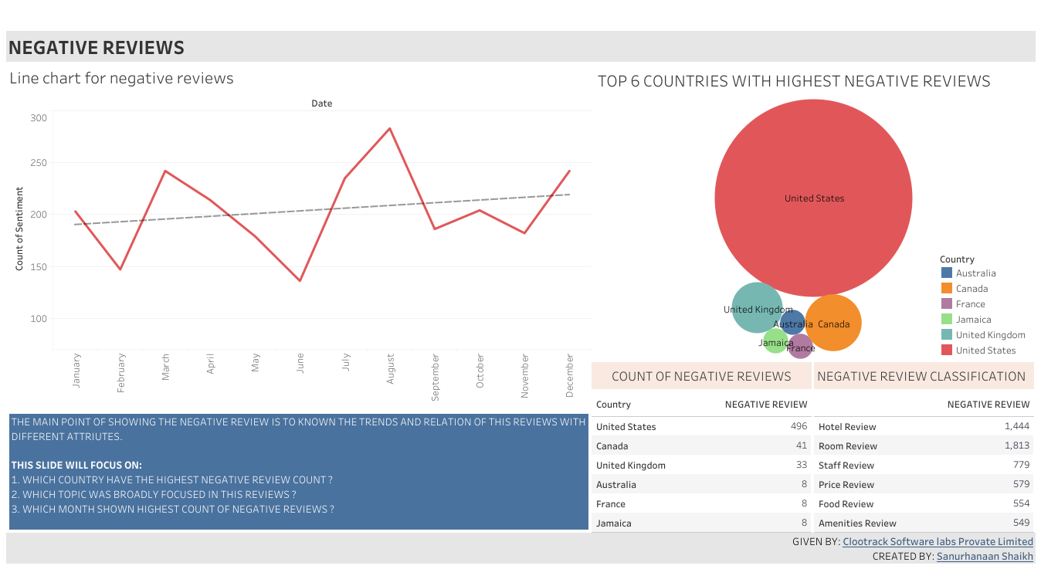

Slide 5
